Slide 1

HEALTHCARE CONSULTING
Bio-Med-Rec

Slide 2
01
02
INTRODUCTION
Problems being faced by the common crowd its solutions
Current health system
TABLE OF CONTENTS
03
04
ANALYSIS
CONCLUSION
Market analysis and graphs to explain solutions
How our project will be successful and reach out to people

Slide 3
There are two blessings which many people waste;health and free time
-Sahi al bukhari

Slide 4

UNDERSTANDING THE PROBLEM
Medical emergencies are situations, encountered in individuals’ lives, which need immediate assessment and management. Proper approach and quick action can save lives. Quick action needs quick diagnosis, which usually is not possible in present medical setup as It consumes much time to evaluate the medical details and medical history. Not only in emergency cases but also on regular basis, maintaining medical report hard copies is a difficult task, and also it can be an adverse effect if the reports are mismatched.

Slide 5
1,69,00,000
Cases of Deaths due to delayed medical records and services from 2010 in India
-Times Of India

Slide 6
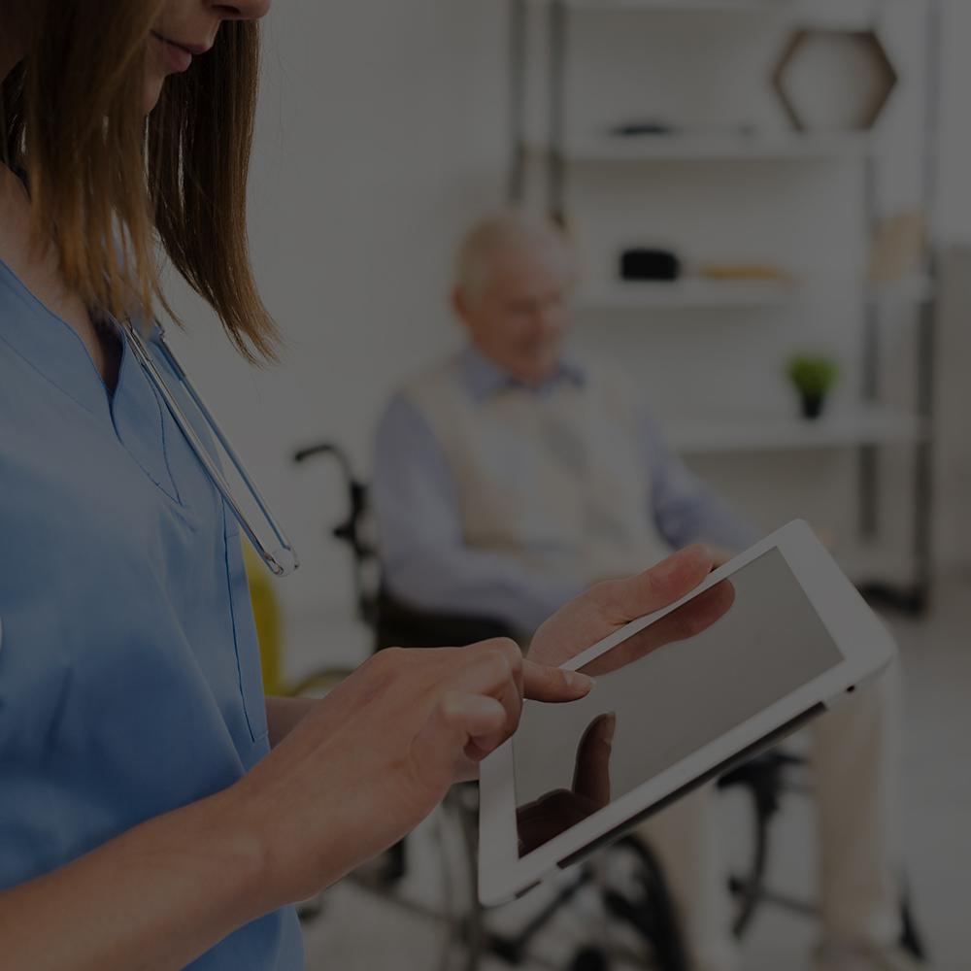
OUR COMPANY
BIO-MED-REC is the short form of “BIOMETRIC MEDICAL RECORDS” It is one point solution through which we can shorten the time of diagnosis and get all medical details like blood group, co morbidities, addictions, medication, heredity, diseased state, surgeries case sheets, social behaviour and other medical history in no time.

Slide 7
CURRENT HEALTH CARE SYSTEM
-Right Information at Right time is not available
-Doctor’s try to evaluate but it consumes much time
-Doctors way of approach is same for every patient without knowing his/her previous history.
-In emergency conditions patient cannot give his medic details
Patient attender cant have all details
-Handy health records are unorganized and have a chance of being misplaced
-Some times attenders are unaware of patients addictions which results in adverse reaction.

Slide 8

Working of the project

Slide 9
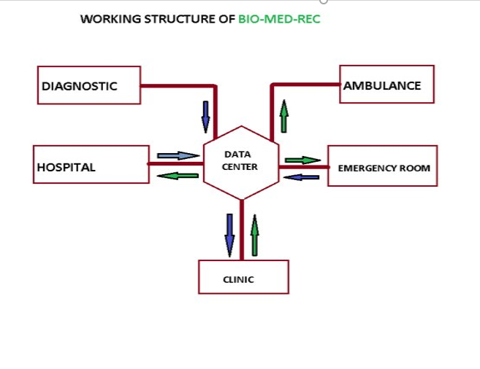

Slide 10
Reducing waiting time for patients and increasing doctors productivity time .
umbilical Cord preservation number, location and address.
Graphical presentation of blood pressure, Diabetes etc.
Money and time saving solution.
Department wise prescription and reports will be available
Reports will directly be uploaded in your profile when the patient authenticate by checking his name on the app it will be saved until it will be on hold , this is the best security we are providing .
No need of visiting diagnostic centre for reports .
MOST significant is it is safer for patients and doctors , without touching any paper or any report doctors can attend patients especially in pandemic like current COVID-19
According to NDHM we have to add few more options it is a government approved program and we have to follow its guidelines.
Helpful for doctors by sharing just patient id other doctors can check the patient profile and can guide junior doctors

Slide 11

User Interface
1) Emergency page
2) reports page
3) Medication page
4) surgery page and summary
5) recent

Slide 12
OUR PROCESS
01
02
03
04
Adding medical records
Reducing the appointment time
Priority to emergency cases
Data science to prevent and eradicate diseases before they affect a person

Slide 13
OUR SOLUTIONS
ICT
Principle
Application based software using ICT (INFORMATION & COMMUNICATION TECHNOLOGY
The Application based software, works on the basic principle of “data sharing from centre to centre"
Emergency Page
Ambulance
It is the first page to open when the biometric is scanned to get complete crucial patient health information
The application allows you to call an ambulance which is the closest to you at the moment of emergency

Slide 14
BUSINESS MODEL
We are charging for our service
Hospital registration
Diagnostic registration
Clinic registration
Patient registration
Every single visit of patient to doctor or diagnostic will generate revenue.
And every year renewal charges will be applied .

Slide 15
Calculation
900 hospitals per day minimum 30 patients will attend .
900×30= 27000 patients per day .
27000×7 rupees = 1,89,000
189000×1.5 =2,83,500
1.5 % extra we consider for
patients prescription.
Total earnings in a day sum upto 2,83,500 rupees .
The registration fee for each person would be 50-100 rs as we are providing them with smart cards.
We will be charging each hospital and diagnostic centre a minimum fee of 25k-50k.

Slide 16

Hospital earnings
When ever any record is uploaded from hospital or diagnostic centre they will be earning to 7 to 10 rupees.
Nowadays hospitals and diagnostic centres are creating pdf's and sending to patients for free. Here with us, they will be earning for their work

Slide 17
TARGET
GENDER
$15 million per annum
37%
63%
Men
Women
PROSPECTS
A
infants
Aged people
B

Slide 18
PROJECT REQUIREMENT & FINANCIALS
Software team (python, block chain )
Biometric devices Pr smart card scanners and cards
Total capital amount can we calculated once a blueprint will be ready.
Revenue :
In Hyderabad there area minimum 900 hospitals and 1500 diagnostic centres only Vijay diagnostic Center have 48 centres in the city.
Minimum earning is 400000 per day this we are earning just from Hyderabad .
CALCULATION will be explained at the time of personal meeting.
HEALTH CARE DATA IS A CRUDE OIL .

Slide 19
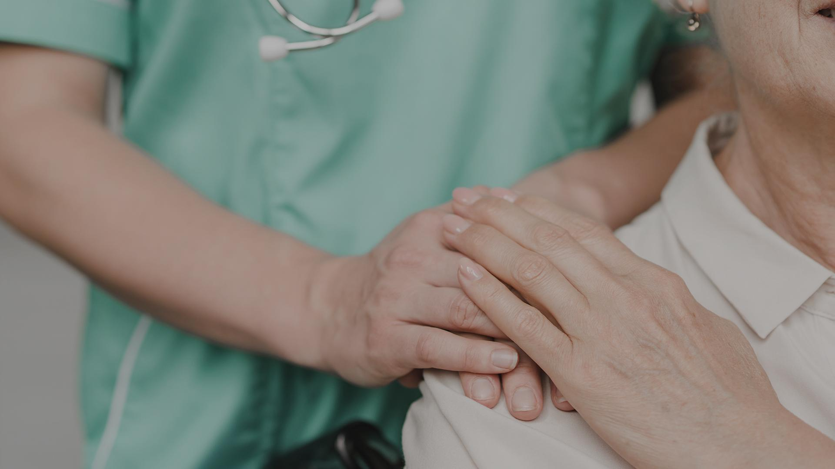
A PICTURE IS WORTH A THOUSAND WORDS

Slide 20
COMPETITION
Government had launched guide lines in 2016 even after that no one showed interest in E.H.R.
Due to this pandemic telemedicine was risen and companies thought of E.H.R.
In India no company has started , but after NDHM launched by government everyone is approaching it as start-up
Many hospitals like Yashoda and apollo are currently saving the records but it is their for internal purpose.

Slide 21
OUR COMPETITORS
1. PRACTO:
*Online pharmacy,appointments,bookings, lab tests,doctor information(work experience,location,reviews)
*details of medicine and prescriptions
*Stores medical records,reports and history of patients for future use
*medicine reminders and new articles everyday
*free questions anytime
*all over India ,Singapore,phillipines,Indonesia & Malaysia
2. 1Mg:
*Online pharmacy,appointments,bookings,lab tests & health check-ups
*Online doctor consultation
*allopathic medicines,Ayurvedic herbs, homeopathic pills and other health products
*awarded as India's only ISO/IEC 27001 and Legit script certified online healthcare platform
What can we add ?
*advanced medical calculators,allopathy and Ayurveda,auto-session switch option for doctors and patients,healthcare products.
*our main competitors- PRACTO,1MG,EPOCRATES

Slide 22
MARKET OPPORTUNITY
We have to create an opportunity on our own by creating a space in healthcare industry.
Before someone else initiates it, we have to stand and create an awareness among the people ,and this is how we can gain more customers.
Product Quality , unique UI, proper approach, high level marketing and political influence can make us win the race.

Slide 23
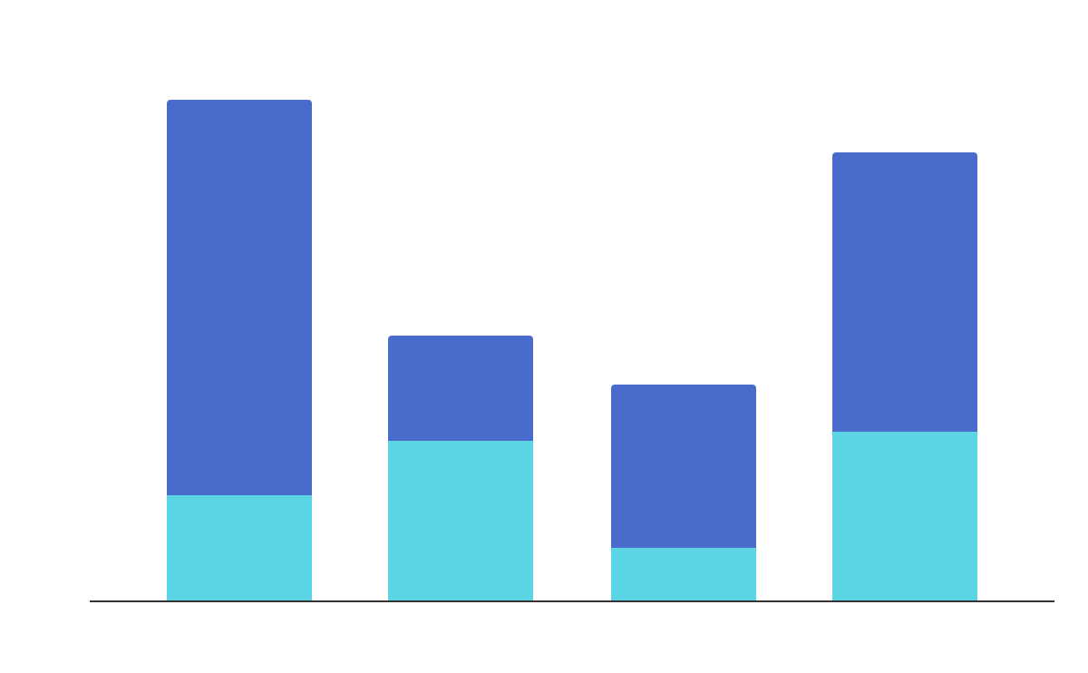
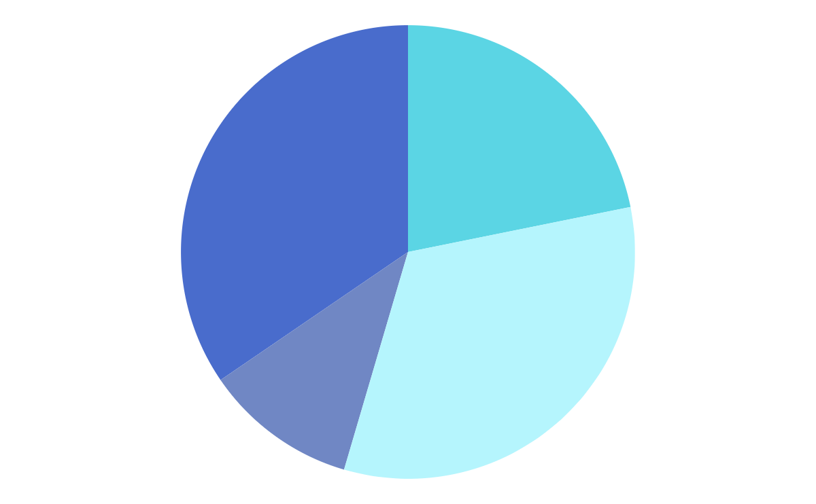
MARKET RESEARCH
Age 25-40
Age 40-70
Age 16-25
Age infants-15
Pregnancy
Hereditary
General
emergencies
Age sectors
EVOLUTION
This pie chart tells us about the age sectors of people taken by average in a hospital in India
This bar graph tells us about the different type of medical records taken by average in a hospital in India.

Slide 24
ANALYSIS
Smart cards
Use of smart cards instead of finger prints for safety
Blood donation portal
Healthy people could donate their blood for a good cause
Security
Health record analysis is, simply put, a comprehensive evaluation of a patient's medical record. You can think of the medical record as a story, since it describes everything that occurred during the care an individual patient received
Information of a patient is secure in the data base

Slide 25
UPCOMING GOALS
Prediction of any serious diseases that the patient might be facing in future
Proper treatment can be provided before health deteriorates
The introduction of data science
01
02
03
04
05
Here the data is based on the previous statistics of patients
Diseases that the patient can be informed as a precaution

Slide 26
TEAM INTRODUCTION
SR
SFA
Z
AW
MA SHAKER RAHEEM
SYED FARZAN AHMED
DR.ZUBAIR
ABDUL WAHEED
B.TECH EEE. site Engineer at 2 commercial projects
Sharath city capital mall,
RGIA-Expansion project
Jr. Scientist at Laser Quantum Ltd. Contact: 8520802588 (Whatsapp only)
Author in Drug Design & Discovery. University of Salford, England. recently research paper was published in UK .
AWS-AMAZON Contact : (8985333790)
M.B.B.S, APOLLO HOSPITAL
Contact : (9391126064)

Slide 27



raheemu6@gmail.com
+91 97006 05614
Bio-Med-Rec

